Slide 1
Semantic Parsing with Syntax- and Table-Aware SQL Generation
Yibo Sun, Duyu Tang, Nan Duan, et al.
Harbin Institute of Technology, Harbin, China
Microsoft Research Asia, Beijing, China
Microsoft AI and Research, Redmond WA, USA
ACL 2017
汇报人 胡梦琦

Slide 2
Outline
Background
Methodology
Experiment
Conclusion

Slide 3
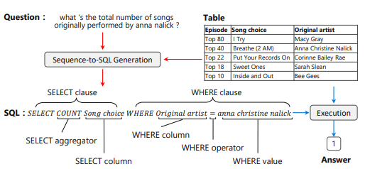
Background
Task: Map natural language questions into SQL queries

Slide 4


Background
Key words
Column names
SQL
Cell values
Challenges
Match between question words and column names/cells
Users do not always use exact descriptions
e.g. “How many schools did player number 3 play at?”
Select count (School Club Team) where No. = 3

Slide 5
Background
Contributions
Learning to replicate content from column names, cells or SQL keywords
Improving the generation of WHERE clause by leveraging the column-cell relation
Tuning model with RL strategy
Raising execution accuracy from 69.0% to 74.4% on WikiSQL
Assumptions
Query over single form (no JOIN/FROM)
Non-nested queries

Slide 6
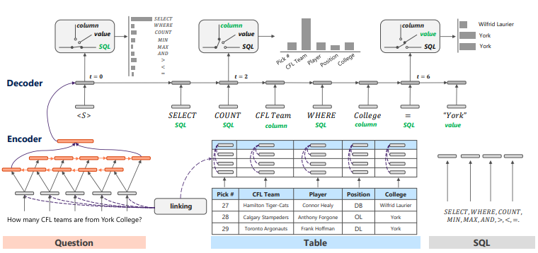

Methodology

Slide 7
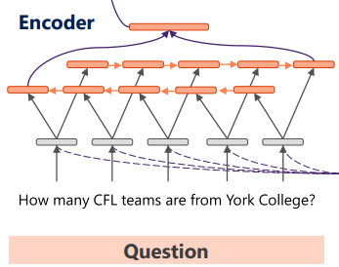
Methodology - Encoder
③
Takes in a question
Feeds the input to a Bi-RNN with GRU
Concatenates both ends for decoder
②
①

Slide 8

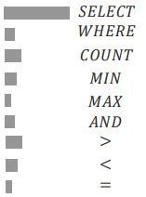
Methodology – SQL channel
Attentional neural network

Slide 9
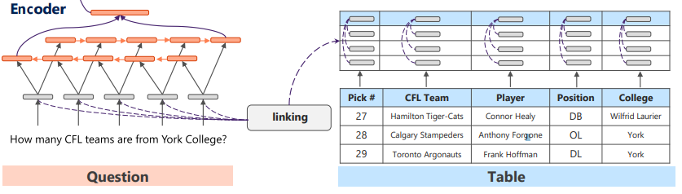

Methodology – Column channel
Leveraging column-cell relation
Use the number of cell words occurring in the question to measure the importance

Slide 10

Methodology – Value channel
Only calculated over the cells belonging to the last predicted column name
“Player = York” should not appear
Incorporate word co-occurrence between question and cells
learned from attentional NN
weights mentioned in last slide

Slide 11

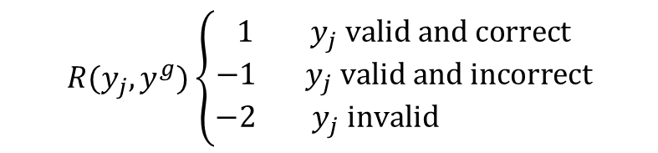
Methodology – Policy gradient improvement
Different SQL queries might be executed to yield the same result
How many teams in New York?
SELECT COUNT (CFL Team) WHERE city = New York
SELECT COUNT (College) WHERE city = New York
Fine-tune using Reinforcement Learning
$$R(y_{j},y^{g})\left\{\begin{aligned}1 y_{j} valid &and correct \\ −1 y_{j} valid and incorrect \\ −2 y_{j} invalid \end{aligned}\right.$$
size of sampled generated SQL queries
ground truth

Slide 12
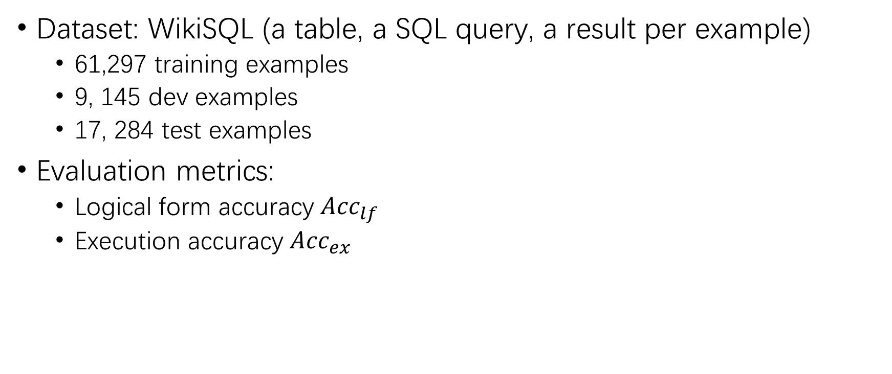
Experiments - Setting
Dataset: WikiSQL (a table, a SQL query, a result per example)
61,297 training examples
9, 145 dev examples
17, 284 test examples
Evaluation metrics:
Logical form accuracy ${Acc}_{lf}$
Execution accuracy ${Acc}_{ex}$

Slide 13
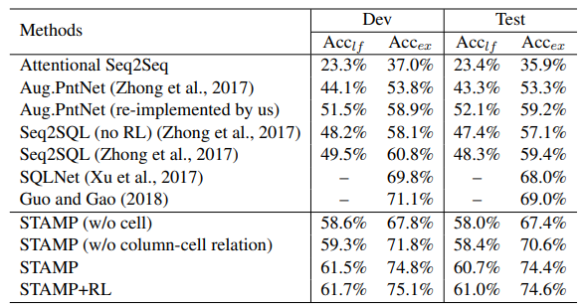
Experiments – Model comparisons
w/o cell: WHERE values come only from the question
w/o column-cell relation: removing enhanced column vector

Slide 14
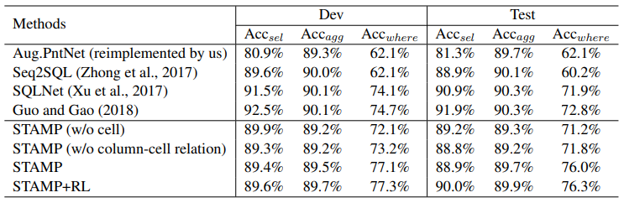
Experiments – Fine-grained accuracy
SELECT column, SELECT aggregator, WHERE

Slide 15
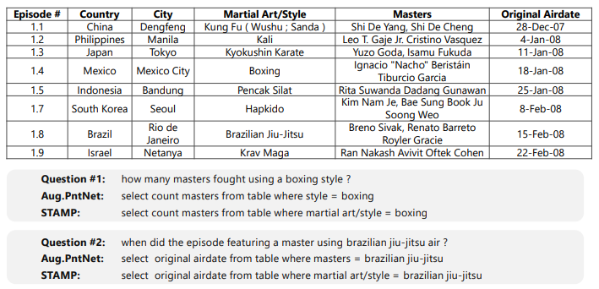
Experiments – Case study

Slide 16
Experiments - Transfer to WikiTableQuestions
Apply STAMP on WikiTableQuestions
Further train STAMP over pseudo question-SQL pairs
Method | Test accuracy
Zhang et al. (2017) | 43.3%
Krishnamurthy et al. (2017) | 43.7%
STAMP | 14.5%
STAMP + *pseudo pairs | 21.0%
*Pseudo pairs: Question from WikiTableQuestions and correct SQL query generated by STAMP

Slide 17
Conclusion
Good points
A Syntax- and Table-Aware semantic parser
Leverage cell information and column-cell relation
Future work
Query over multiple relational databases
Nested SQL query as condition value
More operations such as GROUP BY and ORDER BY

